Slide 1
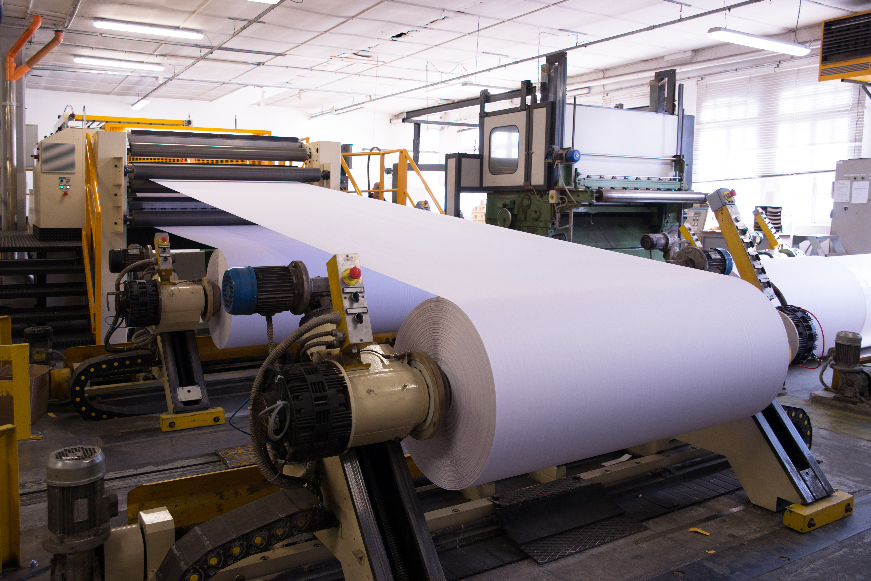
East Canada Paper
Customer Project Handover
Anne-Marie Fiore, Ed.D.

Slide 2
Technical Tasks
As part of the handover strategy for East Canada Paper, the handover of the following technical tasks will be completed and agreed upon:
Monitoring
Troubleshooting
Security
Deploying updates and new functions

Slide 3
Business Process Checklist Items
Identify examples of business process-related items that you will include in the handover checklist.
Do East Canada Paper (ECP) users know how to
view the list of suppliers meeting certain criteria?
place an order?
view sales trends?
analyze operational data?

Slide 4
Support Process Checklist Items
Identify examples of support process-related items that you will include in the handover checklist.
Does the support team know how to fix an issue in the delivery date format?
Does the support team know how to include an additional field in the sales reports?

Slide 5
General Data Protection Regulation
Identify an action you would take with respect to GDPR during the handover process of the East Canada Paper SAP implementation project.
Remove sensitive data about East Canada Paper and its business partners unless there is a legally acceptable reason to keep it.
Execute the data destruction process.

Slide 6
Customer Sign-off
When you seek sign-off on the project from East Canada Paper, you must ensure that:
All deliverables were provided to East Canada Paper.
A qualified support team is in place.
The end-users know how to operate the solution.
The goals set by East Canada Paper were achieved.

Slide 7
Thank you!

