Slide 1
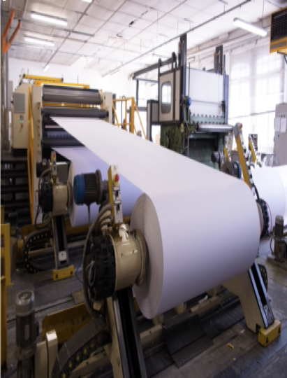
ECP Customer Journey Roadmap
Future Ready with Anne-Marie Fiore, Ed.D.
SAP Technology Consultant

Slide 2
Overview
East Canada Paper (ECP) – multi-national paper production and recycling company. ECP has four divisions:
Milling – billion-dollar mill campus in Quebec Province. On the campus are two large mills, four paper production machines, and two state-of-the-art paper recycling plants.
Local Sales and Recycling – manages Canadian, US, and third-party access to recycling services with offices in Montreal, Vancouver, New York, and Los Angeles.
International Sales – sales offices located in Frankfurt, Mexico City, Singapore City, Cairo, and Mumbai.
Paper and Industrial Products – operates the mills and paper production facilities and manages the design of paper products.

Slide 3
Business and Technical Requirements (1 of 5)
East Canada Paper – Implementing end-to-end functionality will streamline ECP's operations, increase its competitiveness, and improve its bottom line. Integrate ECP's existing systems to achieve end-to-end functionality for:
Improved efficiency and productivity
Better decision-making
Increased agility
Enhanced customer experience
Improved supply chain management
Enhanced financial management
Better compliance

Slide 4
Business and Technical Requirements (2 of 5)
Milling
Automated production control and monitoring systems: ECP operates large-scale paper production facilities that require constant monitoring and control to ensure efficient and safe operation
Local Sales and International Sales
Customer relationship management (CRM) systems: ECP has a large customer base and needs to effectively manage its interactions and relationships with local and international customers.

Slide 5
Business and Technical Requirements (3 of 5)
Recycling
Automated production control and monitoring systems: ECP operates large-scale paper production and recycling facilities that require constant monitoring and control to ensure efficient and safe operation.
Paper and Industrial Products
Data analytics and business intelligence tools to collect and analyze data from various sources, including production processes, customer interactions, and market trends, to make informed decisions and continuously improve its business.

Slide 6
Business and Technical Requirements (4 of 5)
Can you describe your current technology infrastructure and how it supports your business processes?
What are your current pain points and challenges with your technology?
What are your business goals for the next 12-24 months and how do you envision technology supporting those goals?
How do you currently manage and store data, and is this working well for you?
Will you be expanding to any new countries and need to comply with other regulations?

Slide 7
Business and Technical Requirements (5 of 5)
How do you currently handle security and privacy for your data and customer information?
What are your regulatory and compliance needs?
How do you handle software updates, maintenance and support for your technology systems?
Are there any upcoming changes or growth initiatives that will affect your technology needs?
Will in-house IT manage the transition and implement, or will you need external technology support?

Slide 8
Stakeholders and Partners (1 of 3)
Stakeholder | Influence | Interest | Level of Participation
ECP Executive Leadership | High | High | Low
Company and Division Engineers | High | High | High
Company and Division Managers | High | High | Low
IT Representatives | Low | High | High

Slide 9
Stakeholders and Partners (2 of 3)
Stakeholder | Influence | Interest | Level of Participation
Company and Division Analysts | Low | Low | High
ECP Technology Partner | High | High | High
SAP Project Manager | Low | High | High
SAP Technology Consultant | Low | High | High

Slide 10
Stakeholders and Partners (3 of 3)
EY provides a range of services, including implementation and support, for SAP's sustainability and environmental reporting solutions. EY is industry-focused.

Slide 11
Business Environment (1 of 4)
SWOT Analysis
The SWOT analysis allows you to analyze Strengths, Weaknesses, Opportunities, and Threats. SWOT is excellent for assessing "as-is" and determining desired "to-be."
PESTLE Analysis
PESTLE allows you to analyze a company's operating environment. PESTLE factors include Political, Economic, Social, Technology, Legal, and Environmental.

Slide 12
Business Environment (1 of 4)
SWOT Analysis
PESTLE Analysis
PESTLE allows you to analyze a company's operating environment. PESTLE factors include Political, Economic, Social, Technology, Legal, and Environmental.
The SWOT analysis allows you to analyze Strengths, Weaknesses, Opportunities, and Threats. SWOT is excellent for assessing "as-is" and determining desired "to-be."

Slide 13
Business Environment (2 of 4)
Political
Paper products import/export trade policies and regulations.
Environmental policies affecting the paper industry.
Political environment in regions where ECP operates.
Economic
State of the economy where ECP operates.
Change in demand for paper products.
Impact of inflation rate.

Slide 14
Business Environment (3 of 4)
Social
Trends in paper usage and recycling.
Impact of public perception on operations.
Importance of sustainability to ECP's target audience.
Technology
Development of new paper industry technologies.
How technology affects ECP's operations and competitiveness.
Impact of ECP's technology investments on the business.

Slide 15
Business Environment (4 of 4)
Legal
Paper products import/export trade policies and regulations. Paper industry regulations and laws.
Environmental
Environmental law changes
Potential legal risks.
Manage ECP's sustainability effort and environmental impact.
Current environmental industry challenges.

Slide 16
Products and Solutions
Pain Point | ECP/Division | Solution | Notes
Lack of visibility across company | ECP | SAP Integration Suite | Integrate or replace existing solutions
No single source of truth | ECP | SAP Cloud Platform | Solves fragmented reporting processes
No app solution for managing ‘buying event’ | Sales and Recycling | SAP Build Apps | Improve productivity and speed
Lack of monitoring system for water and pulp movement | Milling | SAP Product Footprint Management | Assess footprint and environmental impact
Lack data analysis or business intelligence tool | Paper and Industrial Products | SAP Analytics Cloud | Enables data visualization

Slide 17
SAP Team Training Strategies
Train the team on the SAP products to be implemented
Train team on customer’s existing platforms
Train team to use the SAP Solution Manager for project collaboration, communication, tracking and reporting
Team building exercises

Slide 18
Conclusion
Summary of discovery and explore phases
Preview of analysis and design phases
Value-added benefits of SAP solutions
Streamlined operations, improved bottom line, enhanced customer experience
Reduction of carbon footprint and waste
Visibility of data for better decision making & planning
Partner involvement
Next steps

